Slide 1
2019 TGL Customers CRD Summary Report
Prepared by:
Harry Yu, SA Moy

Slide 2

General SMT Line Layout
Post-Reflow Automated Optical Inspection (AOI)
Pre-Reflow Automated Optical Inspection (AOI) - Optional
Solder Paste Inspection (SPI)

Slide 3
Objectives
Share Findings from CMEE Mobile Industry Data Collection (TGL platform customer survey) – 2019Q3 added wave 2 customers data
    Summarize data collected from the Mobile Customers manufacturers
    (TGL Wave1 target 5 ODMs):
      Quanta CQ (Hp Line)
      Inventec CQ (Hp Line)
      LCFC (Lenovo)
      JDM1 (MSFT)
      Compal KS (Dell Line)
  (TGL Wave2 target 7 ODMs):
      Compal CD (Dell Line)
      Compal CQ (Acer Line)
      Huaqin (Acer Line)
      MSI KS
      Pegatron CQ (Asus Line)
      Samsung Suzhou
      Wistron KS (Lenovo Line)

Slide 4
High Level Intel pkg design and validation requirement based on customer data (1/2)
Continue use type 4 solder paste to do SMT cert: 9/11 customers still using type 4 paste →
4mil/5mil stencil thickness for UP3 package and 3mil/4mil for UP4 packages are the main stream, 5mil stencil still widely used because of other components requirement. 3mil for UP4 also emerged due to ultra small system design of customers →
Keep stencil AR >0.66, 8/12 customers prefer >0.66 as their stencil design rule →
>100~120mm print speed →
Use machine block to support during print, only 3 customer capable for vacuum block →
Panasonic is the main PnP machine vendor, Fuji the 2nd: 8/11 customer use Panasonic, 3/11 use Fuji →
>=0.4mm pitch preferred, All customer capable for 0.4 pitch BGA →
No pallet support during PnP, only support pins →

Slide 5
High Level Intel pkg design and validation requirement based on customer data (2/2)
Most customer use 13 zones reflow oven →
N2 <= 3000PPM, Air reflow still needed, Compal use 40,000 O2 PPM as their reflow environment →
Belt speed 110~140cm/min preferred →
>60s TAL. Some other component, for example black nickel coating type C connector, require longer TAL to form reliable solder joint →
Almost all customer use Aluminum to fabricate their reflow pallet →
Verify tape on board edge reflow, not all customer have spring clamps on their reflow pallet →
No adhesive or UV corner glue, UV glue is more popular than other type of adhesive →
Looks like QUICK is a popular rework station at ODM site →
At least 2, prefer 3 LTS paste vendor is required →
Nobody have thinner film pressure sensor capability in mfg site, all rely on their RD. We should minimize die crack risk in our package design →

Slide 6
SOLDER PASTE PRINT

Slide 7
SAC Solder Paste Formulation (Brand and Model)
Quanta CQ | Inventec CQ | LCFC | JDM1 | Compal KS
Shenmao PF606-P SAC305 Type 4 (Only use this one paste) | Shenmao PF-606P Tamura TLF-204-93(IVT) Yunnan Tin YW9-3005-98CY04 Customer not share the % of the 3 paste usage. | SHENMAO PF606-P Type 4 SENJU M705-S101HF (NL3) Type4 | Senju M705 S101HF(N4)-S5 *Type 5 | Shenmao PF606-P Yunnan Tin YW9-3005-98CY04 Compal random pick Shenmao and YunNan tin, what every available in stock Yanktai NP01-P101-I+ not for Intel BGA
Compal CD | Compal CQ | Huaqin | MSI KS | Pega CQ | Samsung | Wistron KS
ShenMao PF606-P Type 4 YunNan Tin YW9-3005-98CY04 Type4 | ShenMao PF606-P Type 4 YunNan Tin YW9-3005-98CY04 Type4 | ShenMao PF606-P26;PF606-P245 Type 4 Induim 10.8HF Type4 | KOKI S3X58 M406 Type 4 | ShenMao PF606-P Type 4 | SENJU M705-SMH Type 5.5 | N/A
Type 4 paste still the main steam, except JDM1/MSFT
Majority aligned with Intel MAS recommendation
Compal introduced a new local brand paste (Yanktai), but not using it for Intel BGA
Notes:
Put full name for compal KS - Done
% of paste Inventec use? - Done
% for compal - Done

Slide 8
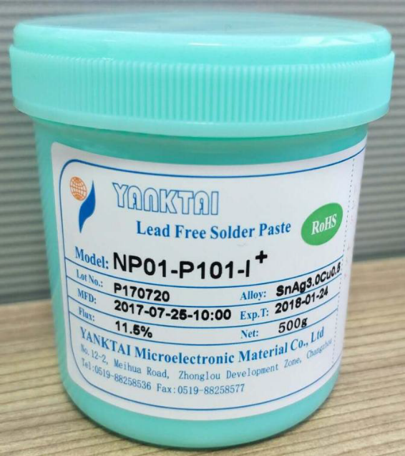
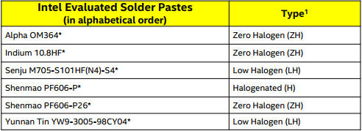
SAC Solder Paste Formulation (Brand and Model)
Mobile/Client
MAS:

Slide 9
Printing machine/Stencil thickness/step stencil
Quanta CQ | Inventec CQ | LCFC | JDM1 | Compal KS
DEK Horizon 03iX; 2011 | DEK; MPM; Hitachi MS310 | HITACH / MS-710/13MS0078-1 / 2014-06 DEK / DEK-GEMINI L-R / 308696 / 2014 | DEK (Horizon 03iX) | GKG, Panasonic
Compal CD | Compal CQ | Huaqin | MSI KS | Pega CQ | Samsung | Wistron KS
GKG; DEK (will phase out) | DEK265; Avg 10 years | GKG, GT++, SN# GL329MS,Y2019; MPM100, SN# M204980, Y2019 | DEK: NEOHORIZON 03IX FUJI: GPX-C | DEK APP/API/03IX, Y2007 | SPEEDLINE Momentum elite 2010/9 | N/A
DEK/MPM still the Main stream
GKG, A China branded print machine is starting used by ODM
Notes:
Try to get the print model name.
% of 4mil and 5mil? For future survey
MSFT ask for 3mil for ICL U for modeling.

Slide 10
Printing machine/Stencil thickness/step stencil
 | Quanta CQ | Inventec CQ | LCFC | JDM1 | Compal KS
Thickness range | U: 4mil(90%)/5mil(10%), Y: 3mil 4mil is first choice for new project | U: 4mil(80%)/5mil(20%); Y: 3mil(40%)/4mil(60%) 4mil is first choice for new project | Y: 3mil U&H : 5mil | Both Y and U use 4mil | Y: 3mil, 4mil, U: 4mil (less) 5mil (more)
01005 on U platform | No | No | Yes, Thinkpad X1 from 2018 | No | Yes
3mil on U package | No need | Yes, some special layout design may require 3mil stencil | Yes, other fine pitch component on the same mother board may need 3mil stencil | No. (PS: MSFT asked for 3mil modeling result on ICL U to study) | Yes, because of 01005 chip
Step Stencil/Smallest step size | Yes, 0.02mm | Yes, 0.02mm | Yes, 0.02mm | Yes. 0.025mm | Yes, 0.02mm
 | Compal CD | Compal CQ | Huaqin | MSI KS | Pega CQ | Samsung | Wistron KS
Thickness range | U: 5mil (100%) Y: no product | U: 5mil (100%) Y: no product | U, H: 5mil Y: 3mil | U: 5mil (100%) Y: no product | U:4mil Y:3mil | U: 0.09mm (3.54mil) Y: N/A | U:4mil/5mil Y:3mil/4mil
01005 on U platform | Not for now | Not for now | Don't know | Not for now | Current no 01005, Smallist 0201 | No ( 0603 ) | No
3mil on U package | No | No | No | No | Yes for U | Yes, because of 0.35 pitch BGA | No
Step Stencil/Smallest step size | Yes, 0.02mm | Yes, 0.02mm | No | Yes, 0.02mm | Yes, 0.02mm | Yes, 0.03mm | Yes, 0.02mm
Various products require various stencil thickness. 3mil for U package in customer wish list but not so many
01005 start be used in some premium product, 2 customers now capable
5mil for U still have needs because of other component requirement
All customers except Huaqin are capable for step stencil
Notes:
Try to get the print model name.
% of 4mil and 5mil? For future survey
MSFT ask for 3mil for ICL U for modeling.

Slide 11
Stencil mfg process/Print process
 | Quanta CQ | Inventec CQ | LCFC | JDM1 | Compal KS
Stencil vendor | Fosen | Sunshine, Fosen | Corcreate | DESCO | Compal Internal LAB(90%~95%), GuangHong, ZuoLiDa
Stencil mfg process | Laser Cut | Laser Cut | Laser Cut | Laser Cut | Laser Cut
Stencil coating | No coat | Nano coat spray + Cure | Nano Coat Sputtering | Nano Coat Spray + Cure | No coat
AR preferred | >=0.66 | >=0.55 | >=0.66 | >=0.6 | >=0.66
Method to achieve smaller AR (<0.66) | Use thinner Stencil | Smaller paste mesh size + Nano coat | Thinner stencil, Smaller paste mesh Size, FG material, Nano coat | Smaller paste mesh size | No plan yet
 | Compal CD | Compal CQ | Huaqin | MSI KS | Pega CQ | Samsung | Wistron KS
Stencil vendor | Sunshine, Fosen, Konwin | Fosen, Sunshine | Sunshine, YiGangDa | Sunshine, ZuoLiDa | Sunshine, Fosen | DESCO, OuFang, BaiSiTeKe | Konwin, Corcreate
Stencil mfg process | Laser Cut | Laser Cut | Laser Cut | Laser Cut | Laser Cut | Laser Cut | Laser Cut
Stencil coating | Spray + Cure | Spray + Cure | Spray + Cure | Wipe | Spray + Cure | No coat | Spray
AR preferred | 0.5 | 0.66 | 0.66 | 0.66 | 0.71 | 0.66 | 0.6
Method to achieve smaller AR (<0.66) | Thinner stencil, Nano coat | Nano coat +Step stencil | Nano Coat, type 5 paste | Nano coat stencil | Nano Coat, type 5 paste | Thinner stencil, Nano coat | Nano coat
Some customer able to achieve lower AR
High end customer are start using advanced stencil mfg process
However, for big volume/low price customer (HP/Dell consumer), cost still a big concern
Quanta said they didn’t feel Nano coating helps (Maybe vendor related), thus they’d rather use thinner stencil to keep the AR >=0.66 than use advanced stencil technology

Slide 12
Stencil mfg process/Print process
 | Quanta CQ | Inventec CQ | LCFC | JDM1 | Compal KS
Print speed | 120mm/Sec | 100mm/sec | 60-140mm/sec | 80--120 mm/S | 100~120mm/sec
Print pressure | 10kg | 10kg | 10~19KG/0.18Mpa~0.26Mpa | 5KG-12 KG | 9kg
Separation speed | 5mm/S | 2mm/s | 0.5mm/s~3mm/s | 0-3mm | 2mm/s
Stencil ultrasonic wash | No ultrasonic wash. Use Air gun and solvent to clear every 24 hrs | every 12Hours | Use solvent, no ultrasonic. Every 12H | 12H/time | 6H
 | Compal CD | Compal CQ | Huaqin | MSI KS | Pega CQ | Samsung | Wistron KS
Print speed | 100~200mm/sec | 110mm/sec | 80~110mm/sec | 70mm/sec | 80-100mm/ssec | 50mm/sec | 80-120mm/sec
Print pressure | GKG:2~8kg；DEK：14~20kg | 8kg | 5~8KG | 10Kg | 8-12kg | 6kg | 6kg-8kg
Separation speed | 1~4mm/sec | 2mm/sec | 3mm/sec | 0.5mm/sec | 0.5mm/sec | 3mm/sec | 1-2mm/sec
Stencil ultrasonic wash | 6 hours | 12 hours | 12 hours | NA | N/A | 8 hours | N/A

Slide 13
Printing Support mechanism/Print machine handing size
 | Quanta CQ | Inventec CQ | LCFC | JDM1 | Compal KS
Print pallet | No | No | No, so far only 1 project use whole process pallet | All process pallet | No
PCB support | Support block with vacuum | Support block | Use support Pin at NPI, use vacuum support block after HVM | Pallet + block | Support Block
Print machine handling size | Size: Max 370mm*420mm，Min 100mm*100mm Thickness: Min: 0.3mm Max: 1.6mm | Size: Max 370mm*510mm，Min 40mm*50mm | L*W 460*366-->50*50 Thickness: 0.2-->5.0 | Min:50*50mm Max:510*508mm Thickness:0.3~6.0mm | N/A
 | Compal CD | Compal CQ | Huaqin | MSI KS | Pega CQ | Samsung | Wistron KS
Print pallet | No | No | Yes, Whole process pallet | No | Normally No. If PCB <0.8mm consider use whole process pallet | No | No
PCB support | Support pin, Support block | Support block | 1st side, support block; 2nd side, support block with vacuum | Support pin, Support block | Support block | Support block with vacuum | Support block
Print machine handling size | Min: N/A Max: 510*590mm Thickness: N/A | Min: 50*40mm Max: 510*480mm Thickness: 0.5mm~6mm | Min: 50.8X50.8mm Max: 609X508mm Thickness: 0.16~12mm | Min: 50.8X50.8mm Max: 508.5X510mm Thickness: 0.4~6mm | Min: 50X50mm Max: 480X504mm Thickness: 0.5~4mm | Min: 50.8X50.8mm Max: 508X609mm Thickness: 0.2~5mm | Min: 50.8X40.5mm Max: 508.5X510mm Thickness: 0.2~6mm
JDM1 always use print pallet (whole process pallet)
  They use both pallet + support block to support PCB during print
few customers are capable for vacuum block

Slide 14
SPI machine
 | Quanta CQ | Inventec CQ | LCFC | JDM1 | Compal KS
SPI machine | Cyber optic SE500,2011 | TR7006 ,TR7007，KOHYOUNG, Most recent machine: TR7007 SII PULS and Holly H510 | KOH YOUNG KY8030-3XDL SPI -83XDL 2012 | Kohyoung (KY-8030L) | holly D686
On 100% pads or 100% on critical parts | Yes, 100% on all pads | Yes, 100% for all pads | 100% all pads | 100% all pads | yes
Paste volume UCL/LCL | 50%~150% | 60%~160% | 40%--170% | 50%--150% | 70%-140%
Calibration frequency | Once a year | Twice a year | 6 months | One time/quarter | N/A
GRR | N/A | Average of GRR value 4% | 10 | GR&R V （1.82%） GR&R H（1.29%） GR&R H（1.29%） | N/A
SPI machine handling size | Size: Max 370mm*420mm，Min100mm*100mm Thickness: Min: 0.3mm Max: 1.6mm | Size: Max 510mm*460mm, Min 50mm*50mm Thickness: Min: 0.5mm Max: 3mm | single track: L*W 510*600 double track: L*W 510*330 thickness 0.4--4mm | MAX W*L:510mm*460mm MIN W*L:70mm*70mm Thickness:0.6~5mm | max：570*480 min：50*50

Slide 15
SPI machine
 | Compal CD | Compal CQ | Huaqin | MSI KS | Pega CQ | Samsung | Wistron KS
SPI machine | Holly; Cyber Opitic SE500 | Cyber Opitic-SE500 Avg 8Y | Sinic tek, Hero-s Model: SP1193412H,Year: 201904 | TR7007SII Plus , T2001750292-002, 2017/05 | TR7006, Y2006 KY8030-L, Y2011 KY8030-3, Y2012 KY8030-2NB, Y2013 | PARMI, HS60D, H6D67410, 2010/9 | N/A
On 100% pads or 100% on critical parts | 100% | 100% | 100% | 100% | 100% | 100% | 100%
Paste volume UCL/LCL | Holly:40%~170%; Cyber:45%~160% | 40%~150% | 40%~190% | 50%~170% | 50%~150% | 60~180% | N/A
Calibration frequency | once a year | once a year | once a year | once a year | once a year | 6 months | 3 months
GRR | Height:111um;Area；93.491%；Volum:92.804% | N/A | N/A | Height 4.05%; Area 3.71%; Volume 5.11% | 4.22 | N/A | N/A
SPI machine handling size | Min: N/A Max: 510*590mm Thickness: N/A | Min: 50*50mm Max: 508*508mm Thickness: 0.3mm~5mm | Min: 50*50mm Max: 460*460mm Thickness: 0.4mm~7mm | Min: 50*50mm Max: 510*460mm Thickness: 0.3mm~7mm | Min: 50*50mm Max: 510*460mm Thickness: 0.6mm~5mm | Min: 50*50mm Max: 390*260mm Thickness: 0.4mm~4mm | Min: 50*50mm Max: 510-510mm Thickness: 0.4mm~5mm
KOH YOUNG, TRI, Cyber Optic and Holly are common used SPI machine

Slide 16
PNP

Slide 17
Pick and Place
 | Quanta CQ | Inventec CQ | LCFC | JDM1 | Compal KS
PNP Machine | Panasonic, NPM,2011 | Panasonic DT401-F, CM602-B Type, 2007&2008 | Panasonic NPM-D NM-E-JM1D 2012 | Panasonic NPM-TT, 2012 | Panasonic NPM-TT
Placement Accuracy (+/- 3 sigma) | 0.03mm | 0.03mm | 0.03mm | 0.04mm | 0.02mm
Largest BGA size | 40mm*40mm*2mm (?) | 100mm*90mm*25mm | L*X*W 45*45*12mm (?) | 80mm*80mm | 120mm*90mm*30mm
Largest BGA weigh | 30g | 100g | 30g max | 30g | NA
Smallest BGA/CSP pitch | 0.4mm | 0.35mm | 0.5mm (?) | 0.3mm | 0.3mm
Pallet usage during PnP | No | No | NO, use pin support | Yes (whole process pallet) | No
Other component to Intel BGA KOZ | KOZ: 2mm; Height: 5mm | KOZ: 1~2mm, Height: 10mm | KOZ 1mm, no requirement for component height | KOZ 0.2mm, Components height 1.2mm | keep out 1mm
In line 2DID traceability | No | No | NO | No | No
Nozzle traceability | Yes | No | No | No | No
Min Max brd handling | Size: Max 370mm*420mm，100mm*100mm Thickness: Min: 0.3mm Max: 1.6mm | Size: Max 510mm*460mm, Min 50mm*50mm | Double track: W 50--300mm L 50--510mm Single track: 50--590mm L 50--510mm Thickness: 0.3--8.0mm | MAX W*L:510*510 mm MIN W*L :50*50mm Thickness:0.4~5.0mm | 50*50 510*590

Slide 18
Pick and Place
 | Compal CD | Compal CQ | Huaqin | MSI KS | Pega CQ | Samsung | Wistron KS
PNP Machine | Panasonic CM DT401; NPM-D3 ,DX | panasonic DT401 | panasonic, NPM-D3/TT2, 1CTV0938, Y2019 | FUJI NXT M6S, M6Ⅲ | Fuji NXT M3/M6, Y2008 Panasonic CM602, DT401 | Fuji NXT2 2010/9 | N/A
Placement Accuracy (+/- 3 sigma) | ±0.01mm | ±0.035mm | ±0.03mm | ±0.025mm | ±0.05mm | ±0.03mm | ±0.04mm
Largest BGA size | 90*90mm | 45mm*45mmm | 90*90mm, 0.3-30mm | 61.3*61.3*25.4mm | 180*180*25.4mm | 74*74*25.4mm | Currrent BGA all OK
Largest BGA weigh | N/A | 30g | 30g | 39.63g | N/A | N/A | Currrent BGA all OK
Smallest BGA/CSP pitch | CM:0.4mm; NPM:0.3mm | 0.4mm | 0.3mm | 0.15mm | 0.4mm | 0.35mm | Currrent BGA all OK
Pallet usage during PnP | No | No | Only for project use whole process pallet | No | Normally no, T<0.8mm use whole process pallet | No | No
Other component to Intel BGA KOZ | Follow layout | Space: 2mm Height: N/A | Space: 2mm Height: 3mm | Space: 2mm Height: 0.5mm | Space: 0.2mm Height: N/A | N/A | Space: 0.5mm Height: N/A
In line 2DID traceability | No | Yes | Yes | No | Yes | No | Yes
Nozzle traceability | No | Yes | No | No | Yes | No | Yes
Min Max brd handling | Min: N/A Max: 510*590mm Thickness: N/A | Min: 50*50mm Max: 510*460mm Thickness: 0.3mm~4mm | Double tracks: 50*50 mm~510*300 mm Single track: 50*50 mm~510*590 mm Thickness: 0.3-8mm | Min: 48*48mm Max: 534*510mm Thickness: 0.4mm~6mm | Min: 50*50mm Max: 480*504mm Thickness: 0.5mm~4mm | Min: 48*48mm Max: 534*280mm Thickness: 0.4mm~6mm | Min: 50*50mm Max: 510*460mm Thickness: 0.3mm~4mm
Panasonic have the biggest market share, followed by Fuji

Slide 19
REFLOW

Slide 20
Reflow oven
 | Quanta CQ | Inventec CQ | LCFC | JDM1 | Compal KS
Reflow Oven | REHM,2011 | Rehm VXP945N RP-2041 7/2018 | Rehm VXS944 RS-0448 2012/03 | HELLER | Heller 2043
# of zones | 13 heating zones; 4 cooling zones | 13 heating zones; 4 cooling zones | 13 heating zones; 5 cooling zones | 13 Zones | 14 Zones
N2 usage and O2PPM | Yes, O2 < 3000PPM | Yes, O2 < 3000PPM | Yes, O2<1000PPM | Yes, O2 800~1200PPM;2000-3000PPM | Yes, O2<30,000PPM
Min Max brd handling | Size: 400mm*500mm,Thikcness: 0.8mm. | Size: Max 460mm; Min 50mm (w/o central support), 80mm (w/ central support) | 40-500mm | Min: 50mm Max: 508mm Thickness:29mm | Max 390*450
 | Compal CD | Compal CQ | Huaqin | MSI KS | Pega CQ | Samsung | Wistron KS
Reflow Oven | Heller 2043; Ersa 3/26XL | Heller | Ersa, Model: HOTFLOW326XL; SN: R033A-19D0139/140/141/142/143/144/145/146; Year2019 | Rehm; Model: VXS 834N; Month/Year: 03/2019 | TAMURA; TNP50-6910PM; 2003.8 HELLER; 2043MK5/2049MK5/1913MK3; 2009 | HELLER; 1913EXL; SN:23578-02; 2010/8 | N/A
# of zones | Heller:13+2; Ersa: 13+4 | 13+3 | 13+4 | 11+4 | TRUMTA: 10+2; HELLER: 13 | 13+2 | 13+4
N2 usage and O2PPM | Yes, <40000PPM | Yes, <3000ppm | Yes, <3000PPM | Yes, <1000ppm | Yes, <3000ppm | Yes, <3000PPM | Yes, <1000ppm
Min Max brd handling | Min: 110*110mm Max: N/A Thickness: N/A | Width: 50mm~460mm Length: No limit Thickness: NA | Width: 60mm~580mm Length: No limit Thickness: N/A | Min: 50*80mm Max: 460*510mm Thickness: 0.4~1.6mm | Min: 50*50mm Max: 480*504mm Thickness: 0.5~24mm | Width: 50mm~250mm Length: No limit Thickness: N/A | Width: 100mm~400mm Length: No limit Thickness: N/A

Slide 21
Reflow profile
 | Quanta CQ | Inventec CQ | LCFC | JDM1 | Compal KS
Peak temp | 240-250C | 235~250℃ | 235--250C | 237-245C | 235~250C
TAL | 60-90s | 60~120s | 60-90s | 50-65s | 40~70s
Ramp and Cooling down rate | 3C/S | 1~3C/S | 1~3C/S | Ramp up: 0.8~1.3℃/S(40~237) Ramp down: 250℃~220℃≦3℃ | <3c/s
Belt speed | 140cm/min | 120cm/min | 100-140cm/min | 100-120cm/min | 130cm/min
Delta T across Intel BGA | <5C | 2~3℃ | <5C | <3C | N/A
 | Compal CD | Compal CQ | Huaqin | MSI KS | Pega CQ | Samsung | Wistron KS
Peak temp | 235~250℃ | 235℃~245℃ | 235℃~245℃ | 235℃~245℃, current use 240℃±2℃ | 240℃~250℃ | 235℃~245℃ | 230℃~250℃
TAL | 40~70S | 50~90s | 40~90S | 60~90S, current use 70~80S | 60~90s | 30~70S | 40~60s
Ramp and Cooling down rate | Up:1~3℃/S; Down:-5~-1℃/S | ±3°/S | Up: 1-3c/s; Down: 1-6c/s | 1~3℃/sec, current at ~1.7c/s | Up: 1-3; Down: -1--3 | Up: 1~3 ℃; Down: -3~-1℃ | 1~3c/s
Belt speed | 120~140cm/min | 110cm/min | 110~120cm/min | 100cm/min | 80~130cm/min | 90cm/min | 120~160cm/min
Delta T across Intel BGA | N/A | <2° | <5° | <1° | 5°~10° | N/A | 1°~2°

Slide 22
Reflow pallet
 | Quanta CQ | Inventec CQ | LCFC | JDM1 | Compal KS
Pallet material | Aluminum | Aluminum | Aluminum | Aluminum | Aluminum
Whole process pallet or reflow only | For reflow only | For reflow only | For reflow only | All SMT process | For reflow only
Tooling pin usage | No tooling pins | No tooling pins | No tooling pins | Two Tooling Pins | No Tooling Pins
Minimum clearance | 1mm | 0.5mm | 0.5mm | Calculated CTE by PCB length | 0.5mm
Brd clamps method | Automatic clamps | Automatic clamps | Spring clamps | Tape on edge | No board clamps
Manual tape on print pallet or not | Yes, manual tape if use print pallets, at both pass | Yes, manual tape if use print pallets, at both pass | Yes, manual tape at both pass, but very few project use it | Tape at both pass | No, not using clamps
How to decide use top hat | We do not use top hat | Depend on PCB warpage measured by our QA lab, and NPI SMT yield | Normally no top hat. If PCB T<0.6mm, will consider top hat | Depends on PCB thickness and if have shielding/connector and DIP component need to hold down | When there are big shielding/connector and DIP component need to hold down
Pallet thickness | 10mm | 10mm | 8mm | 5mm | 8mm

Slide 23
Reflow pallet
 | Compal CD | Compal CQ | Huaqin | MSI KS | Pega CQ | Samsung | Wistron KS
Pallet material | Aluminum | Aluminum | Aluminum | DuroStone for General pallet Aluminum for dedicate pallet | Aluminum and DuroStone | Aluminum | Aluminum
Whole process pallet or reflow only | Reflow ony | Reflow only | Have both | Reflow only | Reflow Only | Reflow Only | N/A
Tooling pin usage | L shape stop block at 4 corners, no tooling pin | L shape stop block at 4 corners, no tooling pin | 1 tooling pin + cavity | 1 tooling pin + 2 stop block | 2 tooling pins | No tooling pin | No tooling pin
Minimum clearance | 0.2mm | 0.25mm | 0.5mm | 0.5mm | 1mm | 0.2mm | 0.5mm
Brd clamps method | No clamps | No clamps | Top plate | Spring clamps | Spring clamps or top hat | No clamps | No clamps
Manual tape on print pallet or not | N/A | N/A | Manual tape at both passes | N/A | Manual tape at both passes | N/A | N/A
How to decide use top hat | N/A | N/A | Depends on whether need hold down the the connector during reflow | N/A | Tablet/Phone use top hat, NB depends on PCB thickness and warpage | N/A | N/A
Pallet thickness | 8mm | 6mm | 6mm~8mm | 6mm | 8mm | 4.3mm | 6mm
Almost all customers are using Aluminum as pallet material
Except JDM 1, who always use whole process pallet, other ODMs use reflow dedicate pallet (Use whole process pallet when needed in few cases)
Quanta CQ and Inventec CQ developed automatic clamps process ( \\VMSPFSFSSH06\AsiaCQR_Data\Harry Yu\Videos\Inventec CQ reflow pallet auto clamp.mp4)

Slide 24
ADHESIVE

Slide 25
Adhesive
 | Quanta CQ | Inventec CQ | LCFC | JDM1 | Compal KS
Using adhesive for Intel BGA in HVM? |  |  |  | Not on Intel BGA, Only for touch IC and WLCSP.
What are you using |  |  |  | Corner Glue, Underfill, but not Intel BGA
Vendor name and model of the adhesive material |  |  |  | Zymet,UA-2605-B
Dispense Machine | N/A | HTD-420-1C (Taiwan Leh-Yeh Technology ) | axxon / AU77s / 0Au77s1711026/ 2017.11.21 EL / EM-5701N /DS-M2990/2012.10 | ANDA | EM-5701L
Curing Oven | N/A | MA-9CR | TUNG SING /BAT-1500-VF/DS20130301/2013.25 | HELLER | EM-5701U （UV)
Where is the adhesive applied |  |  |  | After FCT, Per customer request
Adhesive reworkable? |  |  |  | Yes
In line or offline |  |  |  | Inline
How is after cure validated | Visual inspection only | Visual inspection only | Visual inspection only | Visual inspection | Visual inspection only
Those blank cells have been surveyed previously, refer to CNL/ICL CRD at back up slide
LCFC and JDM1 apply adhesive after FCT, other ODMs apply before ICT test
ODM only do visual inspect after adhesive application, no deep validation on voiding, coverage, adhesion etc

Slide 26
Adhesive
 | Compal CD | Compal CQ | Huaqin | MSI KS | Pega CQ | Samsung | Wistron KS
Using adhesive for Intel BGA in HVM? | Yes | Yes | Yes | Yes | Yes | Yes | Yes
What are you using | Corner glue | Corner glue | Corner glue and underfill | Corner glue | Corner gule | Under film | Corner glue
Vendor name and model of the adhesive material | U-Bond, UB-4305 (UV) | U-Bond, UB-4305 (UV) | Glue: Loctite 3705 (UV); Underfill: SCT 3109A | JinXuan new material; ZY-303 (UV) | Seayu UV3329 | PRECO-MIWA :10003 White I Shape Underfilm .229mm (9 mils) thick) | ASEC (Underfill)
Dispense Machine | Elite 5701N | Elite EM5701N, Avg 10 years | NORDSON, Q-6800, Q30380, 2019 | HOSTRA, GAEA-1000, 06/2017 | Elite, SSI00-COM-01; AXXON, AU99 | N/A | N/A
Curing Oven | Elite | In house made | KTX-600, 19LSL01, 2019 | Elite, UV703, 05/2017 | Elite; Greative | N/A | N/A
Where is the adhesive applied | After reflow/Before test | After reflow/Before test | Corner Glue: After reflow/Before test Underfill: After test | After reflow/Before test | After reflow/Before test | During SMT | After test
Adhesive reworkable? | Yes | Yes | Yes | Yes | Yes | Yes | Yes
In line or offline | In line | In line | In line | In line | In line | In line | In line
How is after cure validated | Visual Inspect | Visual Inspect | Visual Inspect | Visual Inspect | Visual Inspect | N/A | Visual Inspect
Samsung start to remove the needs of under film, current ~70% of their product have no adhesive for Intel BGA. Only thin PCB project will use underfilm

Slide 27
REWORK

Slide 28
Rework
 | Quanta CQ | Inventec CQ | LCFC | JDM1 | Compal KS
BGA rework tool | Quick, EA-H00.2016 | Ye Ou electric TP500: Year 2015*2 Year 2013*3 TP580:2019*1 | shuttle star / RW-SV600 /90105120067 /2012.10 | SRT，SRT Micra | QUICK EA-H15
Use paste or flux | paste | Paste | Paste and Flux | Solder paste | Paste and flux
Paste/Flux brand and formulation | Shenmao PF606-P | Shenmao PF606-P | Paste: SHENMAO PF606-P Type 4 SENJU M705-S101HF (NL3) Type4 Senju L28-143HF(L)Type4(LTS) Flux: AMTECH /NC-559-ASM | senju/ shengmao, same as printing paste | Shenmao PF606-P (Paste), AIM(NC-254, Flux)
Hole covering during HIMB rework | No we don't have HIMB design | Cut scrapped PCB | Not covering hole | Not covering hole | Not covering hole
Peak temp | 240-250C | 230-250℃ | 235--250 | 235~245℃ | 230~250C
TAL | 60-90S | 40-100S | 60-90s | 50~70s | 30~90s
Ramp Rate | 3 C/S | 1~3 degree C/sec | 1--3 | ＜3℃ | <4C
BGA replacement circle time | 10 min | 20 min | 5 min | about 12 mins | 15min

Slide 29
Rework
 | Compal CD | Compal CQ | Huaqin | MSI KS | Pega CQ | Samsung | Wistron KS
BGA rework tool | QUICK EA-H15 | QUICK EA-EH15, Y2015; IR2015 Y2000 | Ersa, 20217, Y2019 | Shuttle Star, RW E6250U, 09/2014 | N/A | N/A | N/A
Use paste or flux | Paste | Paste | Paste and flux | Paste | N/A | Paste and Flux | Paste
Paste/Flux brand and formulation | ShenMao PF606-P Yunnan Tin YW9-3005-98CY04 | Paste: ShenMao PF606-P; Yunnan Tin YW9-3005-98CY04 Flux: NO CLEAN NC254 (For pad clean) | Paste: ShenMao PF606-p245 Flux: Loctite 450 | N/A | N/A | Paste: SENJU M705-SMH Type 5.5 FULX ALPHA-615 | N/A
Hole covering during HIMB rework | N/A | N/A | N/A | N/A | N/A | Use reflow pallet to cover | N/A
Peak temp | 220~248 | 235~245 | 235~245 | N/A | N/A | 249 | N/A
TAL | 60-90s | 60-90s | 45~70s | N/A | N/A | 10~20s | N/A
Ramp Rate | Up: 1~3℃/S, Down:-5~-1℃/S | 1.5-2c/s | Up: 0~3c/s, down: -4~-1mm/s | N/A | N/A | Same as SMT reflow | N/A
BGA replacement circle time | 16min | 20min | 25min | 35min | N/A | 15min | N/A
QUICK (4/9) and Shuttle Star (2/9) is top 1 and 2, only JDM1 use SRT
BGA replacement circle time range between 5min to 35min

Slide 30
PCB

Slide 31
PCB
 | Quanta CQ | Inventec CQ | LCFC | JDM1 | Compal KS
PCB thickness Range (mm) | 1-1.5mm | 0.8mm~1.2mm | 1.0mm | 0.44-0.85mm, 0.85mm for mother board with CPU | 0.8~1.2mm
PCB type (3,4) | Type 3 | Type 3 & Type 4 | type3 | Type4 | Type 3 & Type 4
Line Width/Spacing (mm or mils) | 3mil line width, 3.5mil line spacing | HDI PCB Width/Spacing: 2.3/2.3 mil | Line width 3mil, Line space 3mil | Width:75μm Spacing:75μm
Smallest BGA pad size (mm) - MD and SMD | SMD, C10M8 | Pitch 0.4 BGA all use SMD pad : Pad 11.7 mil SRO: 9 mil | 0.2 mm circle | MD pad: 210μm SMD pad: 250μm | 0.2mm
RIMB and HIMB Capability | NA, we don't have such design | Yes | yes | NPI now, no HVM product before | HIMB - yes; RIMB - No
Surface finish( OSP, ImAg, ENIG, HASL, Other) | OSP | OSP Intek | OSP | ENIG,OSP | OSP
 | Compal CD | Compal CQ | Huaqin | MSI KS | Pega CQ | Samsung | Wistron KS
PCB thickness Range (mm) | 0.9~1.1mm | 1.0mm | 1.0mm | 1.1~1.3mm | 1.0mm | 0.6mm~1.4mm | N/A
PCB type (3,4) | Type 3 | Type 3 | Type3 | Type 3 | Type 3 | Type 3 , Type4 | N/A
Line Width/Spacing (mm or mils) | Follow layout | Width: 2.5mil, Space: 3mil | N/A | Width: 4mil, Space: 4mil | 3.1mil | MLB PCB 3/3mil HDI 2.5/2.5mil | N/A
Smallest BGA pad size (mm) - MD and SMD | Follow layout | Follow vendor | 0.23mm | 0.254mm | NA | MD: 0.23mm, SMD: 0.33mm | N/A
RIMB and HIMB Capability | No | No | No | No | No | HIMB: Yes, RIMB: No | N/A
Surface finish( OSP, ImAg, ENIG, HASL, Other) | OSP | 0SP | OSP,ENIG | OSP | OSP | OSP ， ENIG | OSP

Slide 32
LTS

Slide 33
LTS
Among the 12 customers we surveyed, only LCFC in HVM, other customers either no reply those question, or reply based on their common sense or own study
 | Inventec CQ | LCFC | Huaqin | MSI KS
Which OEM have discussed on LTS validation or implementation | No | Think pad all introduced LTS from 2018.05 at Intel platform | No | NO
What are the pastes you are currently evaluating or tested with confident? What is your build plans or currently utlizing? | We tested 3 LTS paste, but not use in production | qualifying : Alpha OM550LP-HRL2 qualified: Senju L28-143HF(L)Type4 | No | No
What is your expectation of benefits for LTS adoption / in order for you to adopt LTS? | N/A | To have similar reliability with SAC joint | Reliability same as SAC | Reliability same as SAC
Do you see obstacle / challenges in LTS implementation if LTS can meets the rel performance of your customers? | cost | CPU solder ball are still SAC | N/A | Price
Have you utilize LTS for your products (any type of products)? | No, we just tested it | Yes | No | No
If you implement LTS, do you prefer to have dedicated line for LTS or switch between LTS and SAC designs on the same line? | Dedicate line | Dedicate line | Dedicate line | Same line
Are there any classes of components that with special concern to you if building with LTS? | Fine pitch component, like QFN | No, LCFC will keep on monitoring and let us know if there are any. | No | Pin through hole connector

Slide 34
LTS
 | Inventec CQ | LCFC | Huaqin | MSI KS
What is the minimum number of LTS paste options you would need to qualify to support an HVM product? | 3 | 2 | 2 | 2
Would you consider LTS to be benifitial if the solder paste pricing is still the same with SAC? | Depends on market acceptance | No, current LTS have short life span compare to SAC paste (per paste vendor recommendation:1. Short Stencil life (LTS 0.5hr, SAC 7~8 hour), 2. Short PCB life (LTS 1hr, SAC 2hours), 3. After open the jar: LTS: 8hours; SAC 12hours | Should be | Only if same relibility
Any restriction on only use Halogen free solder paste? | Yes, need use HF paste | Yes | Yes | Yes
Any restriction on Antimony (锑 Sb) content in solder paste? and to what level? | No | N/A | No | No
LTS Solder Paste model (Vendor Name, Formulation Name, Particle Mesh Size) | Alpha HRL1 alloy Tamura Sn Bi58 Yunnan tin Sn Bi57 | Senju L28-143HF(L)Type4, 0.43 and 0.35 pitch use type 5 | No | No

Slide 35
THERMAL MODULE ASSEMBLY/DISASSEMBLY

Slide 36
Thermal module assembly/disassembly
 | Quanta CQ | Inventec CQ | LCFC | JDM1 | Compal KS
Do you have process to evaluate die crack during thermal solution assembly/dis-assembly? | No | No | No, RD will verify it at RD lab. Factory just follow the process instruction from RD | No | No
How do you evaluate die pressure during thermal solution assembly/dis-assembly? | Pessure paper | Pressure paper | No | Pressure paper | No
If you are using film sensor, do you follow Intel's recommended process to condition, equalize and calibrate the film sensor? | N/A | N/A | N/A | N/A | N/A
 | Compal CD | Compal CQ | Huaqin | MSI KS | Pega CQ | Samsung | Wistron KS
Do you have process to evaluate die crack during thermal solution assembly/dis-assembly? | No | No, RD will do it | No | No, RD will do it | N/A | No, RD will do it | N/A
How do you evaluate die pressure during thermal solution assembly/dis-assembly? | Pressure pater | Pressure pater | Pressure pater | Pressure pater | N/A | NA | N/A
If you are using film sensor, do you follow Intel's recommended process to condition, equalize and calibrate the film sensor? | N/A | NA | N/A | N/A | N/A | NA | N/A
None of the ODMs have thin film pressure sensor capability and die crack risk evaluation procedure in their factory
ODM RD at TW (or elsewhere) can do the measurement during thermal module design and provide assembly SOP to factory team

Slide 37
Back up

Slide 38
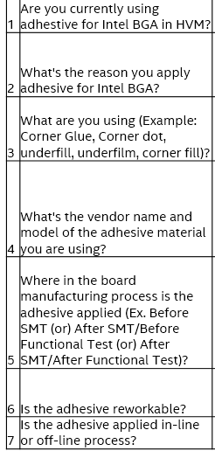
Adhesive on Intel BGA
Adhesive questions that were recently asked during Cannon Lake Platform Introduction, in 2017:
Previously we had not been asking customers about adhesive usage

Slide 39
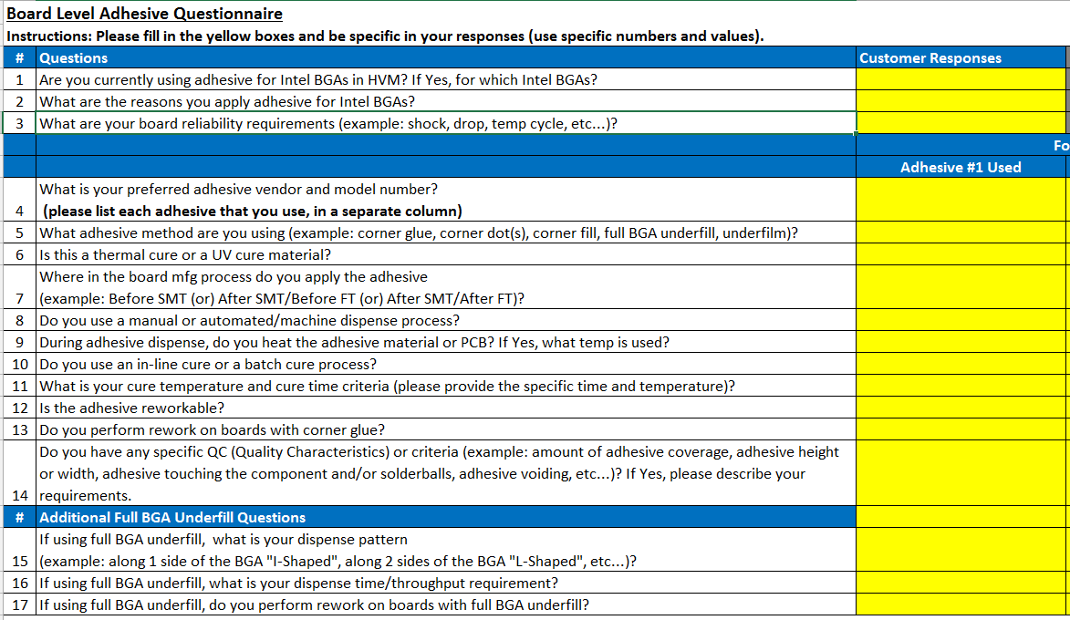
Adhesive on Intel BGA
Updated adhesive questions to be asked (Jan 2018) for a deeper understanding of adhesive usage across the ODM customer base:

Slide 40
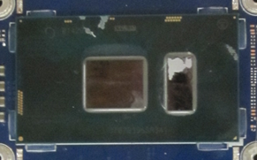
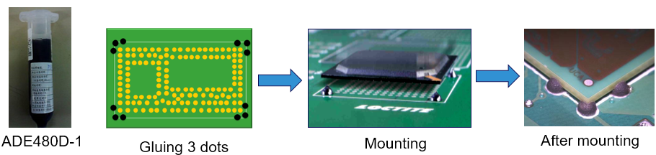
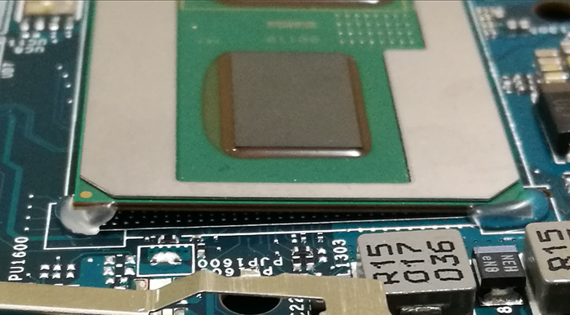
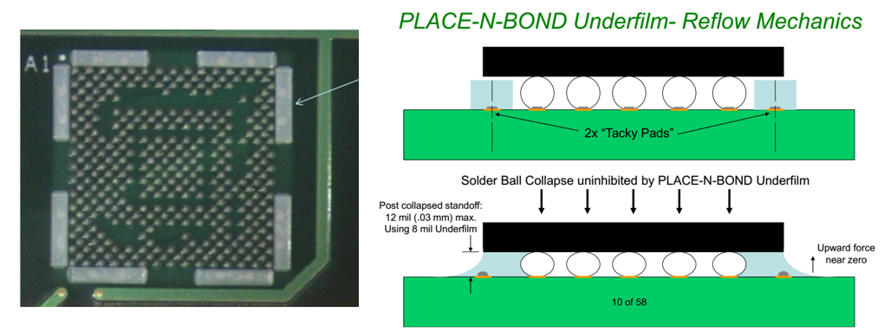
Adhesive on Intel BGA
Corner Dot (Big or Small) Adhesive
Corner “L-Shaped” Adhesive
3 Dots
1 Dot
Pre-SMT Underfilm - Concept

Slide 41
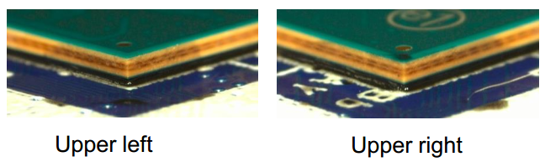
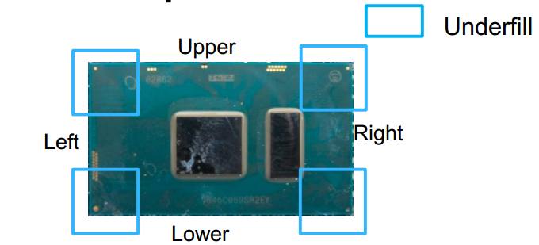
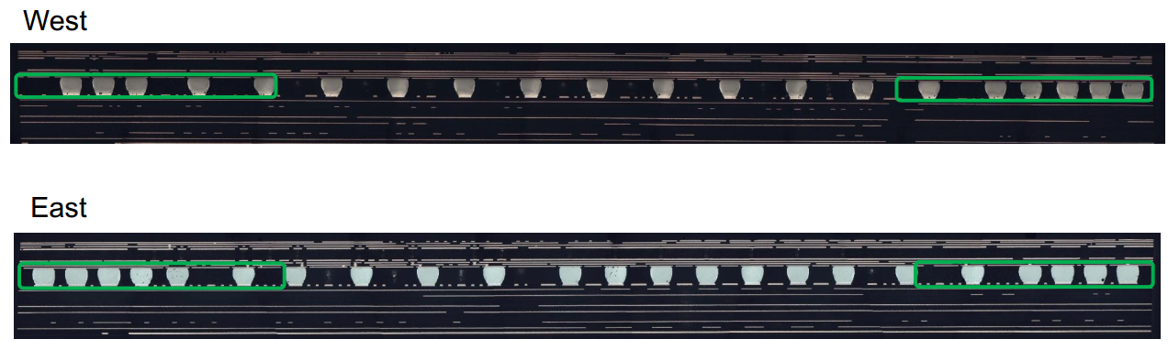
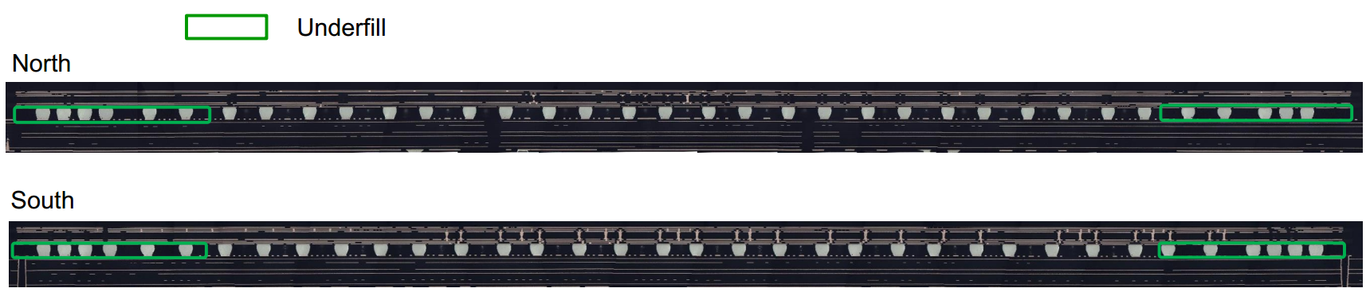
Adhesive on Intel BGA
Corner Underfill (Lenovo Confidential)

Slide 42
Adhesive on Intel BGA (Focused on Laptop & 2-in-1 Manufacturing)
Customer | Y/N | Adhesive shape/location | Vendor name/Model# | Where applied in Factory | Rework-able? | On/Off line
Inventec CQ | Yes | Corner ‘L’ | Loctite 3619 | Before FT | Yes | On line
Quanta CQ | Yes | Corner ‘L’ | Loctite 3619 | Before FT | Yes | On line
Quanta SH | Yes | Corner ‘L’ | Loctite 3619, EICT (UV) | Before ICT | Yes | On line
Compal CQ | Yes | Corner ‘L’ | U-BOND UB-4305 (UV) | Before ICT | Yes | On line
Compal KS | Yes | Corner ‘L’, Corner Underfill (Lenovo) | Corner ‘L’: Loctite 3705 (UV) C Underfill: Likely Loctite 3910 | Corner ‘L’: Before FT C Underfill: After ICT | Yes Hard | On line
Wistron KS | Yes | Corner Dot, Corner Underfill (Lenovo) | Corner Dot:Panasonic ADE480D-1 C Underfill: ASEC-AS3910 | Corner Dot:Before SMT C Underfill: Before FT | Yes Hard | On line
LCFC | Yes | 100% Corner Underfill (Lenovo) | C Underfill: ASEC, COOTEK, TaiLiDe | After FT | Yes Hard | On line
Pegatron SZ | Yes | Corner ‘L’ | 視域:UV649/信友:3329/DYMAX 9-20558/Loctite 3705 (All UV) | Before FT | Yes | On line
MSFT/JDM1 | No
MSI KS | Yes | Corner ‘L’ | ZhongYu ZY-303 (UV) | Before ICT | Yes | On line
Pegatron CQ | Yes | Corner ‘L’ | Xin You UV3329 (UV) | Before FT | Yes | On line
Foxconn WH | Yes | Corner Glue | Loctite 3705 (UV) | After SMT | Yes | On line
Samsung* | Yes | Underfilm | Unknown. Placed by PnP machine onto bd pads. | Before SMT | Unknown | On line
Note: Apple uses Dynamics 26663. Microsoft uses Zymet UA2605.
All major customers applying adhesive on Intel BGA except MSFT (adhesive decision is based on the reliability test results-to prevent SJ cracks)
All major customers are applying adhesive after SMT but before FT test (to prevent SJ crack during FT test), except with the underfill process (it is hard to rework)
Lenovo’s corner underfill covers a minimum of 5 solderballs in all 4 corners
UV glue is more popular than thermal glue, due to less factory floor space & easy to cure
*We know Samsung uses underfilm but the CMEE team did not visit them
Top DT customers (Gigabyte & MSI) seldom add adhesive on Intel PCH (one exception: Asustek)

Slide 43
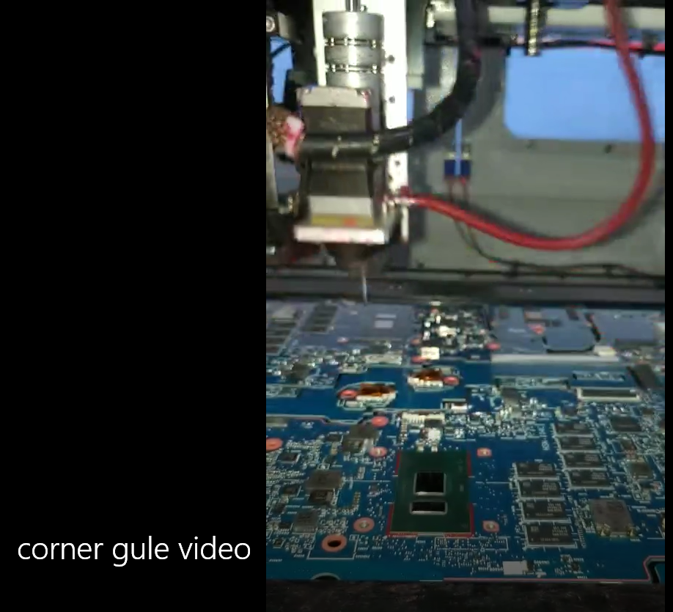
Corner Glue Video (HVM Factory)

